Slide 1

matrimonial website
Through this in-depth examination of wedlock's user base, engagement metrics, and success stories , this report aims to provide a comprehensive picture of the platform's effectiveness in facilitating meaningful connections within the online matrimony landscape.

Slide 2
About us
PROJECT NAME: MATRIMONIAL WEBSITE
GUIDE NAME: ARCHANA.M.
TEAM: AMOGH LOKHANDE (2JH21CS015)
SHRIVATSA DESAI (2JH21CS094)
UMESH NAYAK (2JH21CS115)
ABHISHEK BURUD (2JH21CS003)

Slide 3
CONTENTS
INTRODUCTION
LITRETURE SURVEY
PROBLEM STATEMENT
OBJECTIVE
METHODOLOGY
RESULTS
CONCLUSION
REFERENCES

Slide 4
INTRODUCTION
The institution of marriage has continuously adapted throughout history, and the 21st century has witnessed a revolution in how individuals find their life partners. The rise of the internet has reshaped the matchmaking landscape, with online matrimonial websites emerging as a powerful force in connecting compatible individuals.
We've tried to overcome the traditional ways of finding a partner by using internet as out tool of success,our website show cases how easy it is to find a partner for your self
Our website serves both privcy and purpose to our users so that they can carefree find their sould mates
Through this in-depth examination of [Name of Matrimonial Website]'s user base, engagement metrics, and success stories (if applicable), this report aims to provide a comprehensive picture of the platform's effectiveness in facilitating meaningful connections within the online matrimony landscape.

Slide 5
LITERATURE survey
In today's fast-paced world, online matrimonial websites have become a prominent way for individuals to find potential life partners. This literature survey explores various aspects of these platforms, analyzing their impact, functionalities, and future directions.
The Rise of Online Matchmaking:
Research by s. Rama Gokula Krishnan (Year 2022), A Study on Matrimonial Sites in India" highlights the significant shift from traditional matchmaking methods to online platforms. Factors like social circles, geographical limitations, and convenience are driving this trend.
A review by Jiban K Pal (2015),a review on matrimonial information systems and services" (Indian perspective) emphasizes the potential of online platforms to break down social barriers and facilitate connections across diverse backgrounds and locations.

Slide 6
LITERATURE SURVEY
Key Features and Functionalities:Studies reveal that there are certain attributes of websites that identify a common reasons for why people trust in matrimonial websites
User profile creation with detailed information and preferences.
Advanced search filters based on religion, caste, language, education, profession, and other criteria.
Secure communication channels for messaging and interaction between potential matches.
(Optional) Features like personality assessments, AI-powered compatibility matching algorithms, and video chat functionalities.

Slide 7
Problem statement
The traditional methods of finding a life partner, such as relying on family or social circles, are becoming increasingly limited in today's world. These limitations can include:
Geographic Restrictions: Social circles and arranged marriages often limit options to a specific geographic area, potentially excluding compatible matches from other locations.
Limited Network: Personal networks might not offer a diverse pool of potential partners, making it difficult to find someone with truly compatible interests and values.
Inefficiency of Traditional Matchmaking: Traditional methods like arranged marriages or relying on family connections may not account for individual preferences and compatibility.
Time Constraints: Busy lifestyles can make it challenging for individuals to invest significant time and effort in traditional matchmaking methods.

Slide 8
OBJECTIVE
The primary objective of a matrimonial website is to facilitate meaningful connections between compatible singles seeking life partners.
Here's a breakdown of some key objectives:
1. Connect Compatible Users:
Provide a platform for users to create detailed profiles that highlight their interests, values, and relationship goals.
Implement advanced search filters to allow users to find matches based on specific criteria like religion, education, profession, and lifestyle preferences.
User can shortlist and like other profiles as well.

Slide 9
OBJECTIVE
Enhance User Experience:
Create a user-friendly and intuitive platform that is accessible on various devices (desktop, mobile).
Offer a streamlined registration and profile creation process.
Continuously improve the platform based on user feedback and data analysis.
Foster Safe and Secure Communication:
Ensure user privacy and data security through robust security measures.
Offer secure communication channels like messaging, and potentially video chat, to facilitate interaction between potential matches.
Provide features to report suspicious activity or inappropriate behavior.

Slide 10
Methodology
Project Planning and Requirements Gathering: As we have grew up seeing traditional methods being applied for such an important moment, despite it having several flaws.
Scope and Features: Consider features like:
User registration and profile creation
Search filters based on various criteria
A user can shortlist and like profiles of their choice
There is a medium porvided for communication via messaging.
Users can be searched by using their profile names

Slide 11
methodology
Website Development and Design:
Technology Stack Selection: We have used JavaScript (EJS), html and css as our programming language , node js as our framework and and sql as our database technology of choice
UI/UX Design: A user-friendly and intuitive interface that is visually appealing and easy to navigate.
Development: Code the website functionalities according to the defined user stories and project plan. Ensure robust security measures are implemented.

Slide 12
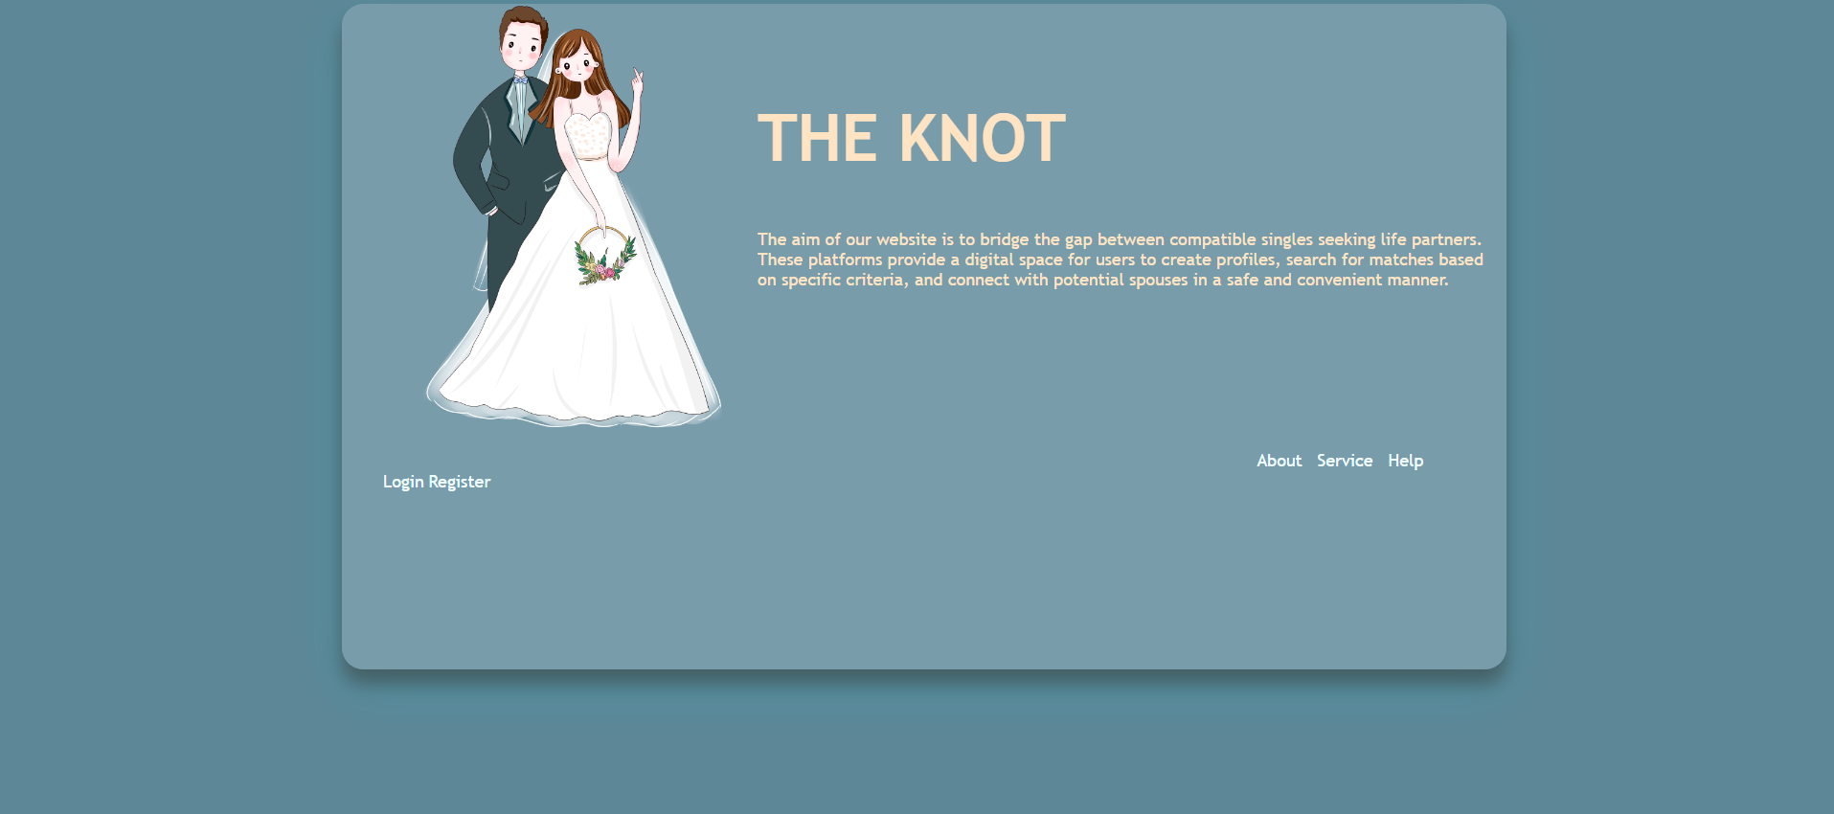
RESULTS: Landing page

Slide 13

Results:Login page

Slide 14
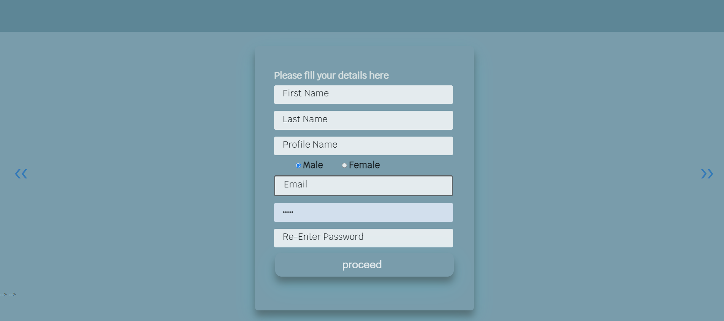
Results:registration page

Slide 15


Results:registration page

Slide 16
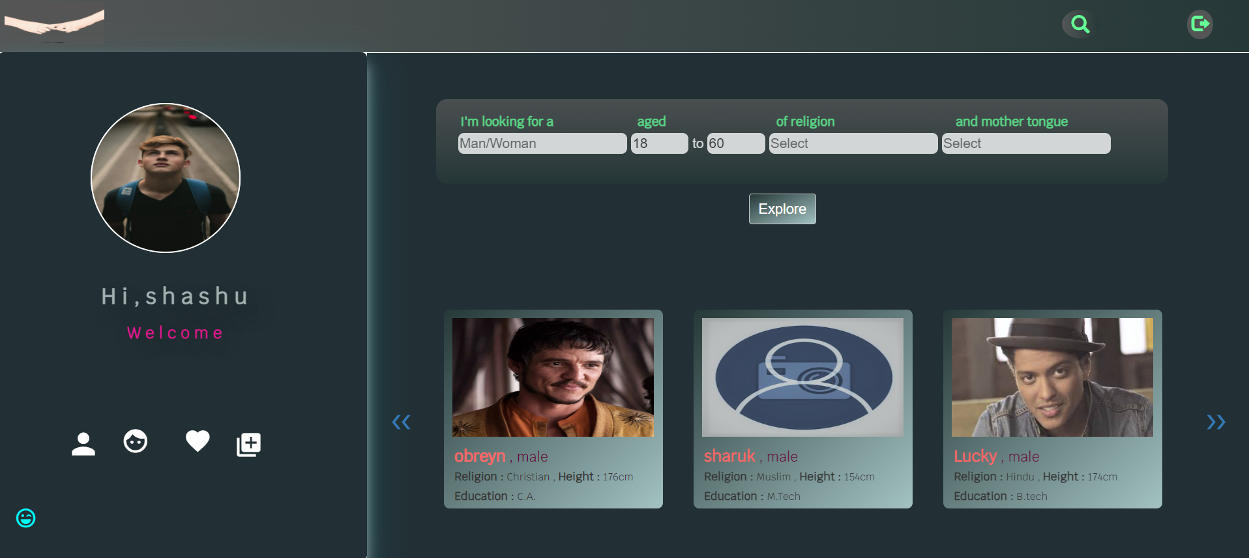
Results:dashboard

Slide 17
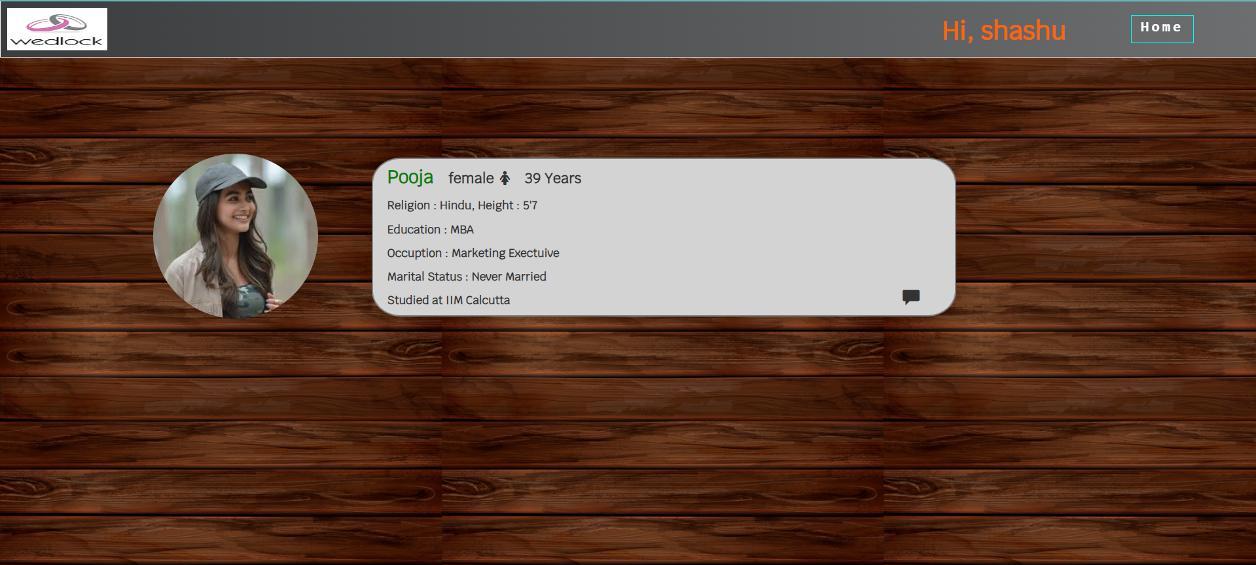
Results: liked profiles

Slide 18
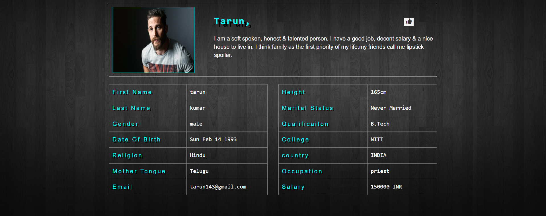
RESULTS: profile page

Slide 19
CONCLUSION
In today's fast-paced world, finding a compatible life partner can be a daunting task. Our matrimonial website is designed to simplify this journey, providing a seamless and enriching experience for those seeking meaningful relationships. With our advanced matching algorithms, user-friendly interface, and robust security measures, we ensure that your quest for love is both enjoyable and secure.
We believe in the power of love and the importance of companionship. Our platform is not just a service; it's a community where individuals come together with shared hopes and dreams. By fostering genuine connections and promoting authentic interactions, we aim to transform the way people find their soulmates.
Join us today and embark on a journey towards a lifetime of happiness and fulfillment. Your perfect match is just a click away, and we are here to support you every step of the way. Let us help you write your own love story.

Slide 20
REFERENCES
The article " A study by Jiban K Pal (2015) in " Review on matrimonial information systems and services – an Indian perspective " explores how advancements in artificial intelligence (AI) and machine learning are being utilized by matrimonial websites to create more sophisticated matchmaking algorithms. These advancements can lead to more relevant matches for users.
The research paper " A Study on Matrimonial Sites in India " by Dr. S. Rama Gokula Krishnan (2018) examines the increasing role of mobile apps in online matrimony, analyzing user behavior and engagement patterns within mobile platforms. Understanding mobile usage trends is crucial for optimizing the mobile app experience.

Slide 21
Scope of improvement
Add feature to edit the profile details of a user
Notifications of messages
No specific algorithms for match making
Enhance security measures and encryption

